Slide 1
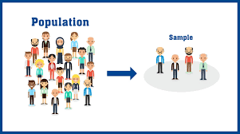

Sampling Methods
By Himanshu Shukla ( statistical Expert & Data scientist)

Slide 2
Population in statistical sense
One should very well keep in mind that statistical population is no only the human population which is usually conceived in literary sense. It is generally a group or collection of items specified by certain characteristics or defined under certain restrictions
A statistical population can be a group of existing objects (e.g. the set of all stars within the Milky Way galaxy) or a hypothetical and potentially infinite group of objects conceived as a generalization from experience (e.g. the set of all possible hands in a game of poker).

Slide 3
Types of Population
Finite Population
Infinite Population
Real Population
Hypothetical Population
Workers in a factory
Stars in sky
Population consisting of the items which are all present physically is termed as real population
Rolling a dice again and again.

Slide 4
what is the need of sampling as compared to complete enumeration
Sampling
Less time
Less Manpower
Less money
Big data
Big Measurement error

Slide 5
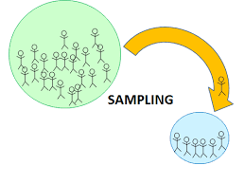
What is Sample
Sample is a part of fraction of population selected on some basis. But keep in mind its principle is it should be true representative of the population.
Two Main Questions
Which technique or method we adopt?
What should be size of sample?

Slide 6
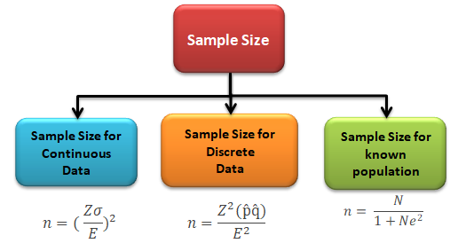
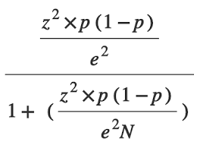
SAMPLE SIZE
Sample size =
N = Population Size
z = Z score
e = margin of error
p = standard deviation

Slide 7
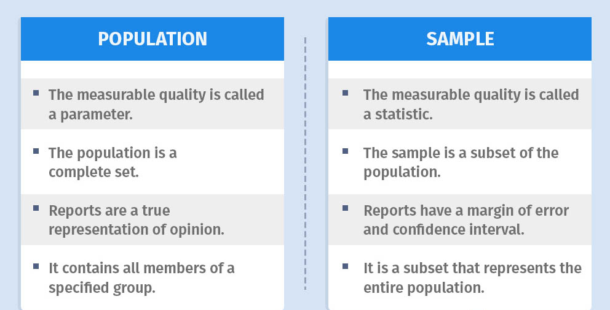
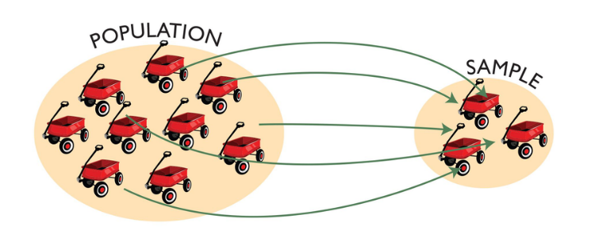
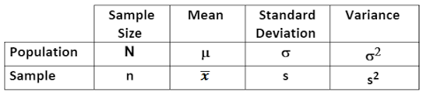

Slide 8
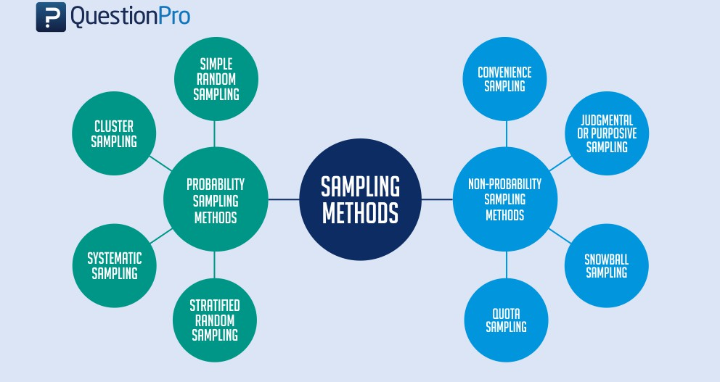
Sampling Methods
Probability Sampling
SRS with replacement
SRS without Replacements
Non-Probability Sampling
Judgement Sampling
Quota Sampling
Stratified RS
Systematic RS
Multi-Stage RS
Cluster Sampling
Purposive Sampling

Slide 9
Non-Probability Sampling
Judgmental sampling /Purposive Sampling
Judgmental sampling is a non-probability sampling technique where the researcher selects units to be sampled based on their knowledge and professional judgment.
It is also known as purposive sampling and authoritative sampling.
Quota Sampling
Quota sampling is where you take a very tailored sample that’s in proportion to some characteristic or trait of a population.

Slide 10
Simple Random Sampling
Probability Sampling
SRS with replacement
SRS without Replacements
Non-Probability Sampling
Judgement Sampling
Quota Sampling
Stratified RS
Systematic RS
Multi-Stage RS
Cluster Sampling
Purposive Sampling
When equal probability of selection is attached to each sampling unit at each draw, the selection procedure is known as random sampling.
Two approaches aim to minimize any biases in the process of simple random sampling:
Method of lottery
Using the lottery method is one of the oldest ways and is a mechanical example of random sampling. In this method, the researcher gives each member of the population a number. Researchers draw numbers from the box randomly to choose samples.
Use of random numbers
The use of random numbers is an alternative method that also involves numbering the population. The use of a number table similar to the one below can help with this sampling technique.

Slide 11
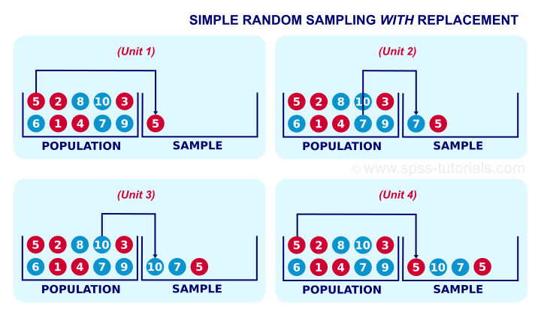
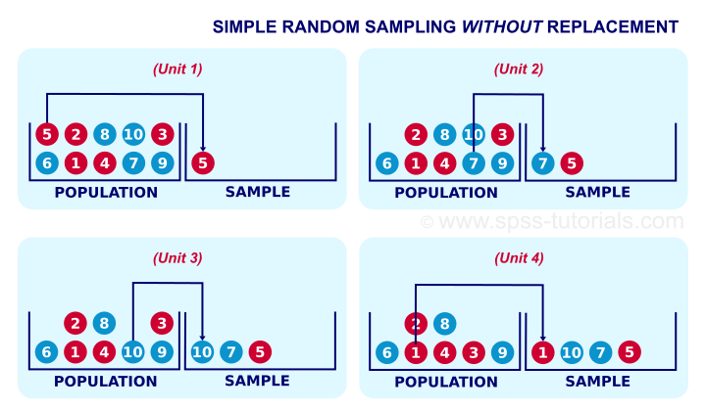
With replacement means the same item can be chosen more than once. Without replacement means the same item cannot be selected more than once.

Slide 12
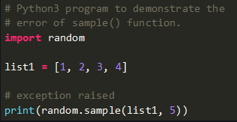


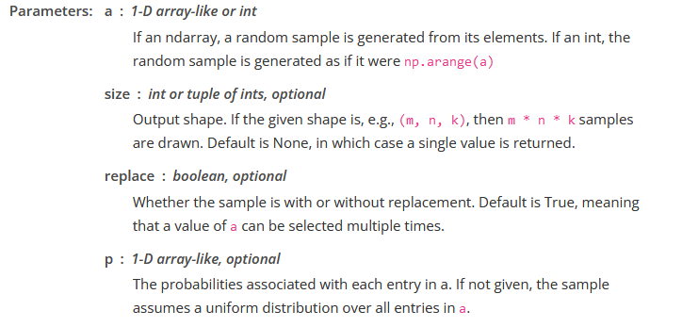
Advantages
Lack of Bias
The use of simple random sampling removes all hints of bias—or at least it should.
Simplicity
As its name implies, producing a simple random sample is much less complicated than other methods.
Less Knowledge Required
doesn't need to have any information or knowledge about the larger population

Slide 13
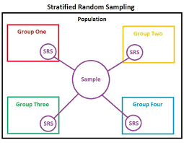
Stratified random Sampling
Probability Sampling
SRS with replacement
SRS without Replacements
Non-Probability Sampling
Judgement Sampling
Quota Sampling
Stratified RS
Systematic RS
Multi-Stage RS
Cluster Sampling
Purposive Sampling
In this method we did sampling in two steps:
First the whole population is divided into homogenous group under certain criterion.( which is called strata)
Second, sample is drawn randomly from each stratum independently.
This sampling comes under the category of restricted sampling.
Strata are formed on some basis such as localities in a city, districts in a state, etc.

Slide 14
Systematic sampling
Probability Sampling
SRS with replacement
SRS without Replacements
Non-Probability Sampling
Judgement Sampling
Quota Sampling
Stratified RS
Systematic RS
Multi-Stage RS
Cluster Sampling
Purposive Sampling
Systematic sampling is a probability sampling method where researchers select members of the population at a regular interval – for example, by selecting every 15th person on a list of the population. If the population is in a random order, this can imitate the benefits of simple random sampling.

Slide 15
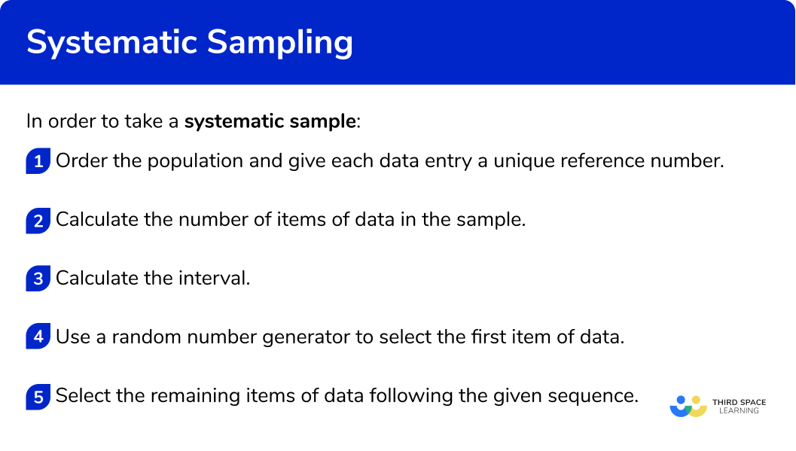
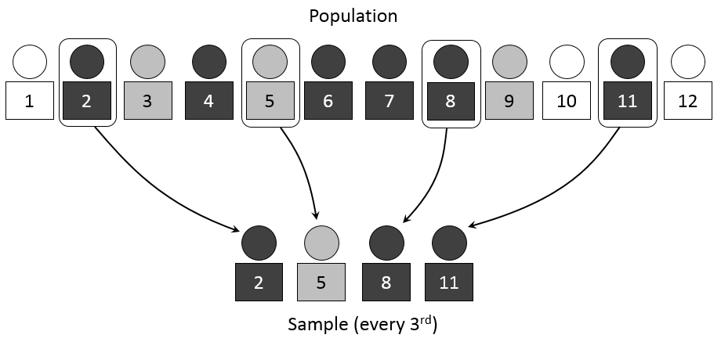

Slide 16
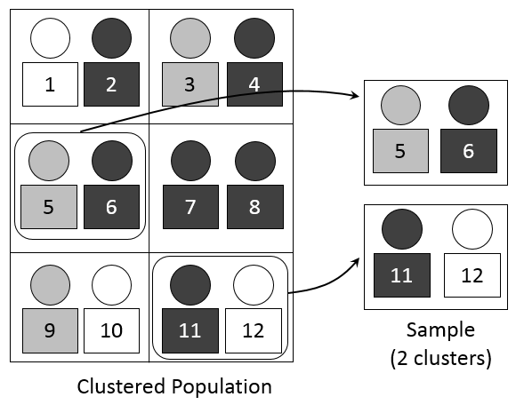
Cluster Sampling
Probability Sampling
SRS with replacement
SRS without Replacements
Non-Probability Sampling
Judgement Sampling
Quota Sampling
Stratified RS
Systematic RS
Multi-Stage RS
Cluster Sampling
Purposive Sampling
Cluster sampling is a probability sampling method in which you divide a population into clusters, such as districts or schools, and then randomly select some of these clusters as your sample.
You thus decide to use the cluster sampling method.
Step 1: Define your population. ...
Step 2: Divide your sample into clusters. ...
Step 3: Randomly select clusters to use as your sample. ... Usually SRSWOR is used to select clusters or area .But can other design be also use
Step 4: Collect data from the sample.

Slide 17
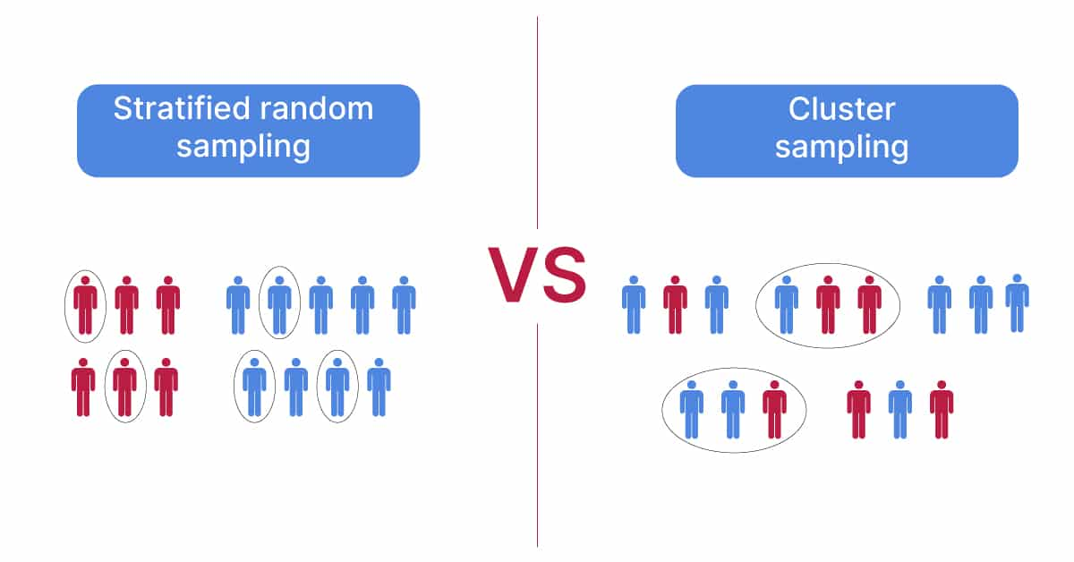

Slide 18
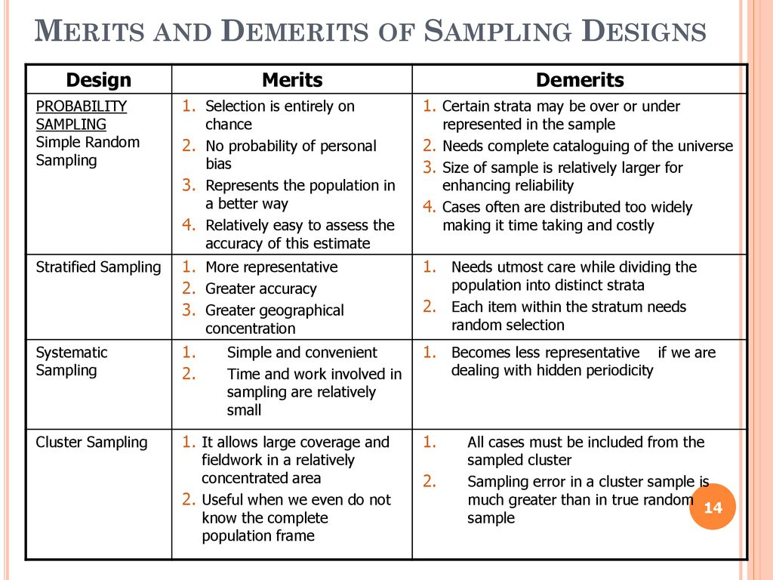

Slide 19

The END
THANKS!
Ab Kuch Puchna Mat, Thoda Khud Bhi padho or Google karo.
You can find me at:
dataindustryhimanshu@gmail.com

